Slide 1
using present continuous
Study the examples in groups and say when the Present Continuous is used

Slide 2
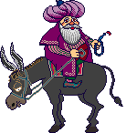
using present continuous
reading
Reading:
Nasreddin Hodja
Darkness
One day the Hodja lost his ring. He searched and searched, but he couldn't find it. Then he got out the house and began to search the ring on the road.
People passing by asked him:
“Hodja Effendi, what are you doing?”
“I've lost my ring at home, and now I'm searching it.”
“Why are you searching it outside?”
“The house is too dark. I can't see anything, so I'm searching my ring outside!”

Slide 3


using present continuous
1
We use the present continuous tense when we are in the middle of action.
I am dancing now.

Slide 4


using present continuous
It is walking now.

Slide 5

using present continuous
He is running.

Slide 6

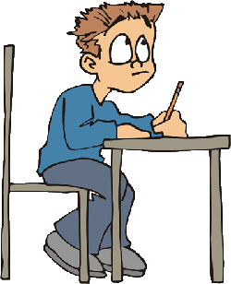
using present continuous
I am doing my homework now.

Slide 7
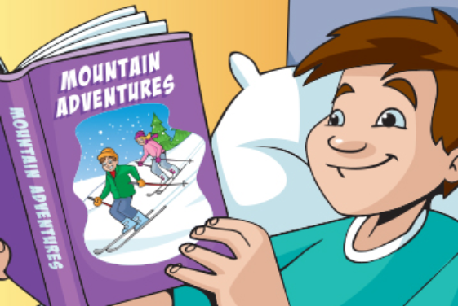
using present continuous
2
We use the present continuous tense to talk about temporary actions and situations that are going on around now.
I am leaning English now? (not exactly at the moment)

Slide 8
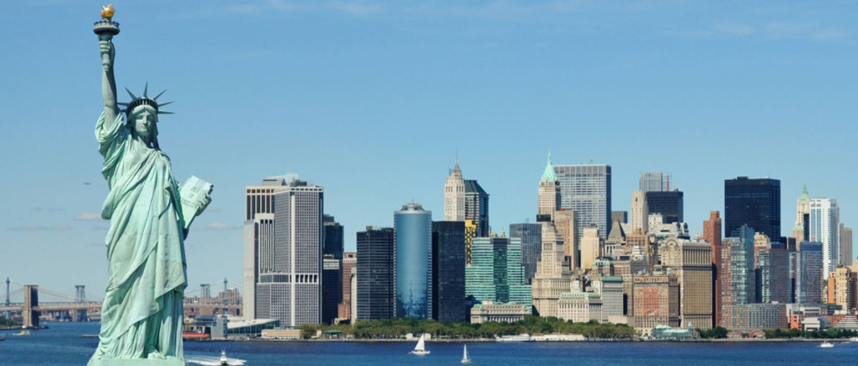
using present continuous
3
We use the present continuous tense to talk about planned actions.
I am leaving for NY tomorrow.
I am meeting a friend on Friday?

Slide 9
using present continuous
4
We use the present continuous tense + always to talk about annoying habits.
He is always coming late!
She is always crying!

Slide 10

using present continuous
no -ing
Non-progressive verbs:
We cannot use these verbs in present continuous tense.
love, like, hate, believe, know, remember, hear, understand…
I am liking this music.
I like this music.
I am knowing the answer.
I know the answer.
I am loving you.
I love you.

Slide 11
The
Present Continuous
Tense
How do we form the Present Continuous?

Slide 12

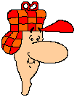
using present continuous
The Present Continuous is:
Pronouns or nouns + am / is / are + doing / going etc.
I am speaking now.

Slide 13
using present continuous
add -ing
Adding ‘-ing’
We add –ing most verbs.
read
ing
reading
Verbs ending in –e, we drop –e and add –ing.
make
making
Verbs ending in –y, we keep –y and add –ing.
try
trying
Verbs ending in a short vowel and a consonant, we double the consonant and add –ing.
run
running

Slide 14

using present continuous
forms
Forms
Positive
Question
Negative
I am working. You are working. He is working. She is working. It is working. We are working. They are working. | Am I working? Are you working? Is he working? Is she working? Is it working? Are we working? Are they working? | I am not working. You are not working. He is not working. She is not working. It is not working. We are not working. They are not working.
are not = aren’t / is not = isn’t

Slide 15



using present continuous
short answers
Short answers:
Are you jumping?
Yes, I am. or No, I am not.
Is he playing football?
Yes, He is. or No, He is not. (He isn’t)
Are you driving a car?
Yes, You are. or No, He you are not. (you aren’t.)

Slide 16














Which statements are true about the Present Continuous?
using present continuous
1
Is used to talk about regular, repeated actions
2
Is used to describe an action in progress
3
Is used to talk about annoying habits (+ always)
4
Is used to talk about planned actions
5
Is used to talk an action that has just started
6
The signal words are: now, at the moment, currently

Slide 17
using present continuous
excercises
Exercises:
Which one is wrong?
a) Are you waiting for a bus?
b) Why are you not listen to me?
c) Are you waiting for a bus?
d) Is she sitting on the table?

Slide 18
using present continuous
excercises
Exercises:
Fill in the blanks with the correct form of the verbs..
1. Look! It ____________.
is snowing
snow
2. John is ____________ now.
working
work
3. Diana _____________ meetings regularly .
has
have
4. They _____________ on phone now.
aren’t talking
not talk
5. He ___________ overtime every weekend.
works
work
6. They _____________ a proposal now.
are discussing
discuss
7. What are you __________?
doing
do
not telling
8. You are _____________ the truth.
not tell
9. I ___________ the answer of this question.
know
know
10. I _____________ English.
like
like

